Slide 1

Handwriting Recognition
Heba Abdelrazzak
Ani Chitransh
Ankit Pal

Slide 2
Introduction
Visually impaired people are dependent on other people to help them read handwritten notes.
Our objective is to build a model that will take images of handwritten text and convert it to speech.
Great social impact & can solve accessibility issues.

Slide 3
Knowledge Gap
There are many models that have attempted to convert handwriting to text using CNN & RNN on the IAM dataset.
Our effort is focused on trying other traditional models to find a better solution.
We used KNN, Random Forest, SVM & Naive Bayes to convert handwritten images to text.
Additionally, we are also converting handwritten text to life-like speech.

Slide 4
Purpose of Study:
Hypothesis
The sole purpose of the study is to test different traditional models and use TTS libraries.
We first need to extract & identify words from the full-page text image.
The next step was to tackle different models to recognize words from images and compare them to already existing methods.
And then finally give a voice to the final reassembled text.
GitHub repo

Slide 5
Methods & Materials
Data Source : https://fki.tic.heia-fr.ch/databases/iam-handwriting-database
This database contains handwritten English text in various formats that can be used to train and test handwritten text recognizers.
It contains unconstrained handwritten text forms, scanned at a resolution of 300 dpi and saved as PNG images with 256 gray levels.
Also, it offers handwriting pages, which have also been extracted into lines and words using an automatic segmentation scheme.

Slide 6
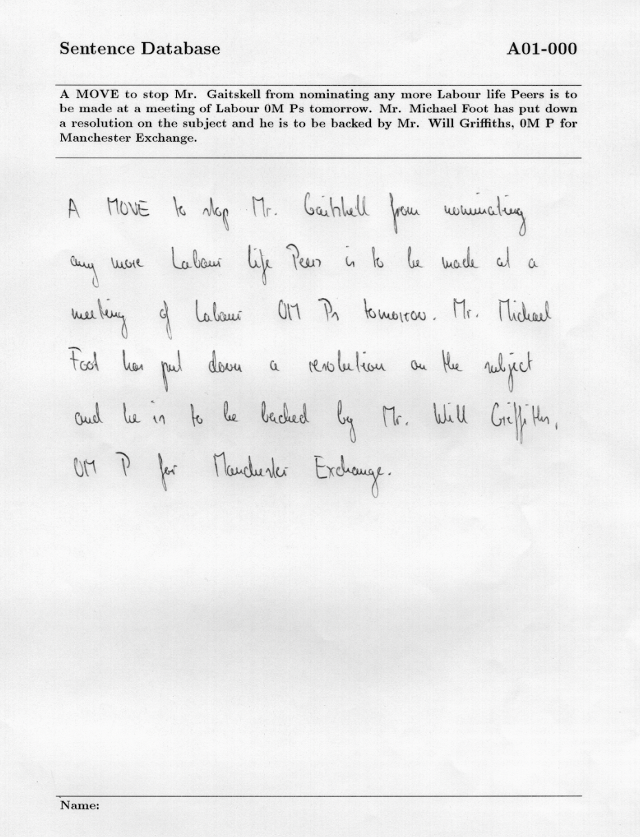
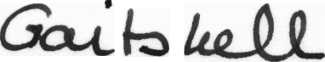
Sample Image :

Slide 7
Analysis
We used the word segmented images from the dataset
Reducing the dataset size (because of limited resources)
Limited Words
Approach 1:
Choosing the most common words from the dataset
Approach 2
Choosing a list of handpicked words from the dataset
Limited Images
Choosing a maximum number of images per word
We chose 200 images per word
Mapping the image to the label of the selected word.
We encoded the labels to map each label to a number
Image Processing
We read the image in grayscale.
We resize all images to a fixed size
We converted each image to an array and normalized it.

Slide 8
Analysis Cont.
We trained the dataset using the K cross-validation method with k=5 with different models:
Naive Bayes
Gaussian
Multinomial
Random Forest
K Nearest Neighbors
Support Vector Machines
For the demo, we did word segmentation of the image using Opencv and predicted the text using the best model
We converted the predicted text to voice using different engines like Google TTS and AWS Polly (For life like Speech)

Slide 9
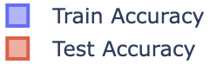
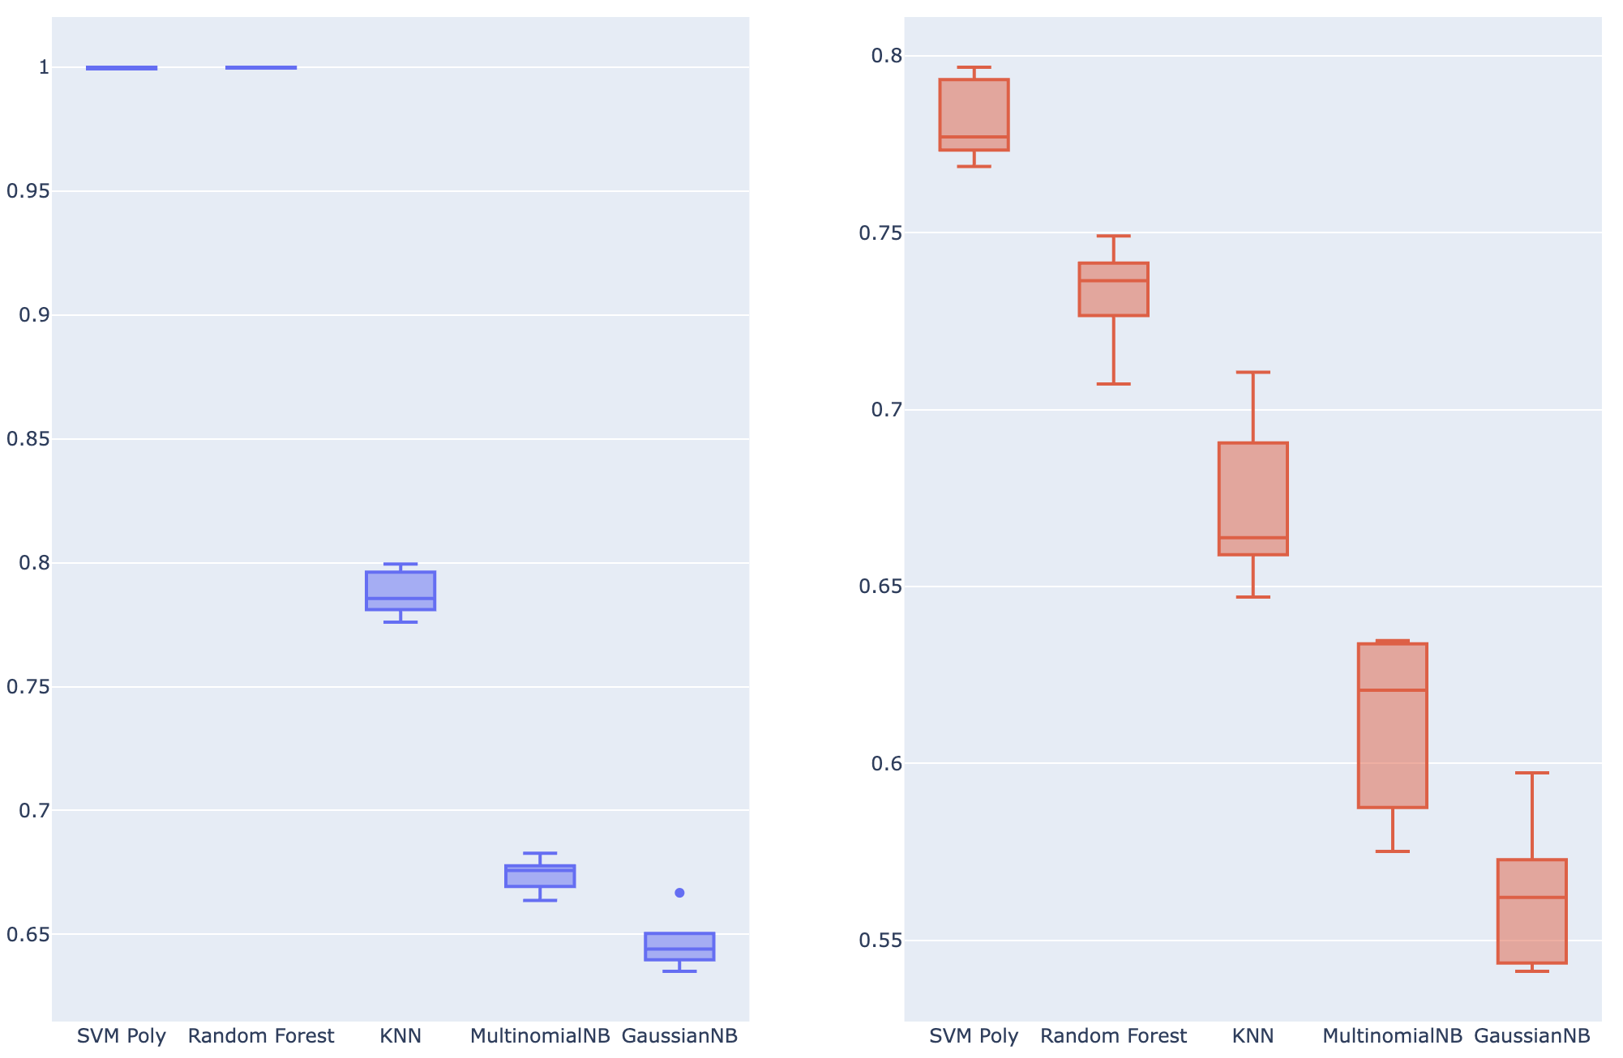
Results :
Accuracy comparison of all the models

Slide 10
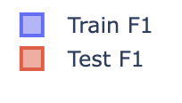
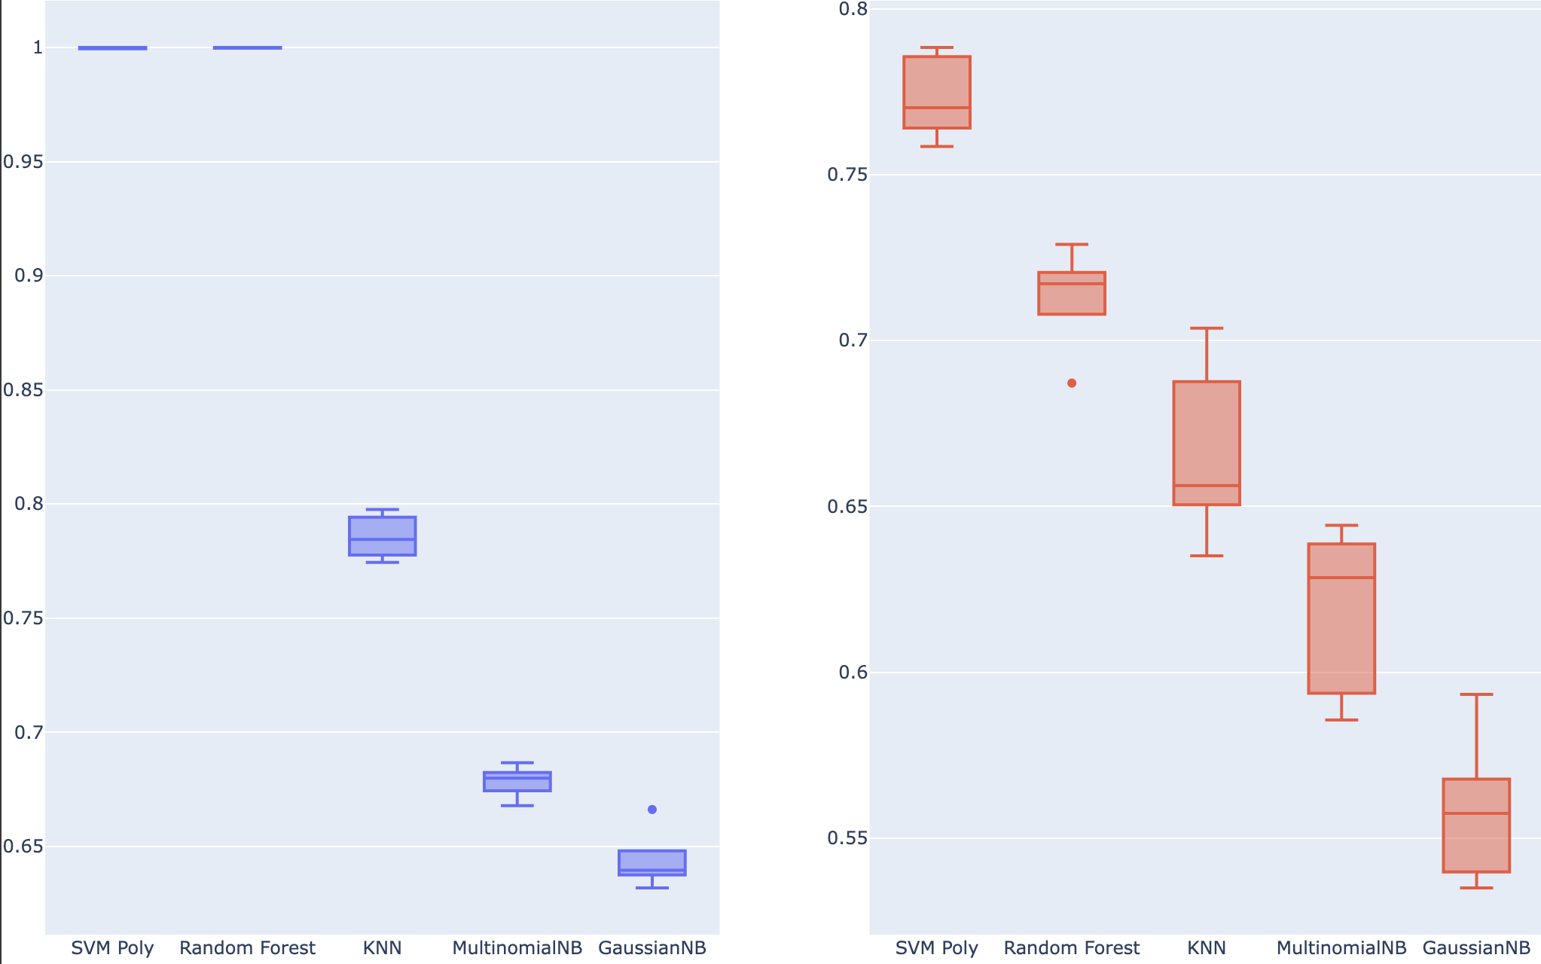
Results :
F 1 score comparison of all the models

Slide 11
Discussion
We can use image to sequence model that does not use image segmentation. Replicating Full Page Handwriting Recognition via Image to Sequence Extraction
We need lots of word images - hard to obtain these images and make sure every word is included, and then it would be computationally expensive to train the model.
All the life-like speech libraries are paid.
Traditions ML models do not work really well.

Slide 12
Demo

Slide 13
Future Work
The traditional models do not perform well so using Neural network models can probably increase the performance.
We have a lot of images to select for each word, sometimes no images at all, so trying Image to Sequence architecture should be preferred.
Emotions are important when you are reading something to make it clear like sad, happy or excited. Introducing emotions to words can be a wide aspect to look at.
We can always take a look at the large & synthetic datasets to work on more images.

Slide 14
Conclusion
We did handwriting recognition using different traditional models and image segmentation. The model with the best performance was Support Vector Machines.
This model is easy to replicate and makes it easy to understand.
The image segmentation approach requires a lot of training data for each word, in order to predict accurately. It does not perform well when the data changes for e.g. curved text, change in height and width, and formatting and indentation is not always preserved.
So, Image to Sequence architecture with Neural Networks implementation seems to be a better method, however it may not be as easily replicated as it is more complex and requires more computational resources.

Slide 15
Thank you!

